Slide 1

Ontology standardisation and interoperability
Stefan Schulz^{1,2}
¹Institute for Medical Informatics, Statistics and Documentation, Medical University of Graz, Austria ²Averbis GmbH, Freiburg, Germany

Slide 2
Learning Objectives
Recognize the necessity of standardisation and interoperability for effective integration of ontologies
Domain ontologies with foundational ontologies
Domain ontologies with other ontologies
Recognizing challenges in classifying concepts into ontological categories
Understand the phenomenon of logical polysemy and how it can be addressed by ontology design patterns
Examples from medicine (main topic disease) and other domains

Slide 3
Some ontologies are recognised standards
Foundational ontologies:
ISO/IEC 21838 “Top-level ontologies (TLO)”: Part 2: Basic Formal Ontology (BFO) Officially recognizes BFO as a conformant top-level ontology standard.
Other TLOs in standardisation process
SNOMED CT:
The most comprehensive global clinical terminology. Maintained by SNOMED International, a non-profit standardization organization
Why standardisation?
Interoperability, Portability, Reliability & Quality Assurance

Slide 4

Example: aligning disease and related concepts (clinical conditions) with upper-level ontology
Common terms occurring in clinical terminology
BFO classes (disjoint)
Independent Continuant
Material Entity
Object
Fiat Object Part
Object Aggregate
Immaterial Entity
Site
Continuant Fiat Boundary
Spatial Region
Generically Dependent Continuant
Specifically Dependent Continuant
Quality
Realizable Entity
Disposition
Role
Function
Process
Process Boundary
Temporal Region
Spatiotemporal region
Poll
1524 k
427 k
61 k
13 k
123 k
47 k
175 k
479 k
177 k
22 k
218 k
Disease*
Disorder
Illness
Sickness
Phenotype
Sign
Symptom
Diagnosis
Condition
Situation
Problem
?
Results
*counts from Pubmed titles

Slide 5
Discussion of poll results
Clinical conditions (diseases, disorders, signs, symptoms): Several viewpoints
Qualities that inhere in some anatomical structure
Qualities that inhere in some process
Dispositions that inhere in some anatomical structure
Processes / events that occur in some anatomical structure
Structural features of interest - phenotypes
State of organism marked by presence of any of a. to e.
Mention of some of the concepts a. – f., regardless of actual instances
Example: Appendicitis

Slide 6
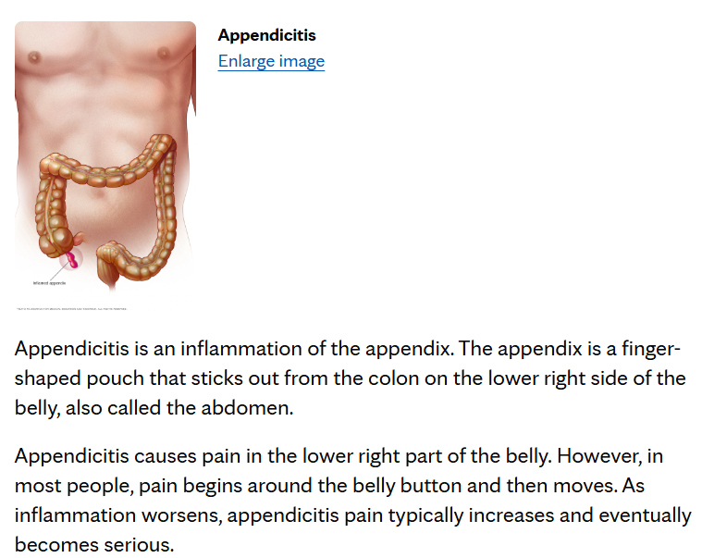
Appendicitis in different biomedical ontologies
Ontologies
MONDO
Integrates multiple disease resources to provides standardized disease definitions, cross-references, and hierarchical relationships
HPO
Describes human phenotypic abnormalities (signs, symptoms, clinical features)
SNOMED CT
comprehensive, multilingual clinical terminology, which covers all entity types used in EHRs for semantic interoperability.
NCI Thesaurus
A reference terminology covering cancer biology, diseases, drugs, genes, and clinical trial concepts.– Provides controlled vocabulary and ontology structure to support cancer research and clinical trials.
Disease Ontology
Standardized ontology for human diseases with mappings to medical vocabularies, using BFO
Appendicitis is an inflammation of the appendix. The appendix is a finger-shaped pouch that sticks out from the colon on the lower right side of the belly, also called the abdomen.
Appendicitis causes pain in the lower right part of the belly. However, in most people, pain begins around the belly button and then moves. As inflammation worsens, appendicitis pain typically increases and eventually becomes serious.
https://www.mayoclinic.org/diseases-conditions/appendicitis/symptoms-causes/syc-20369543

Slide 7
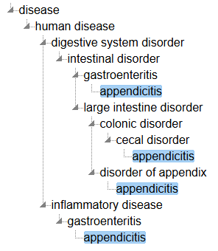
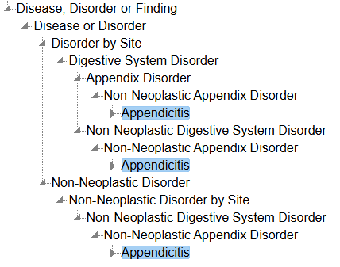
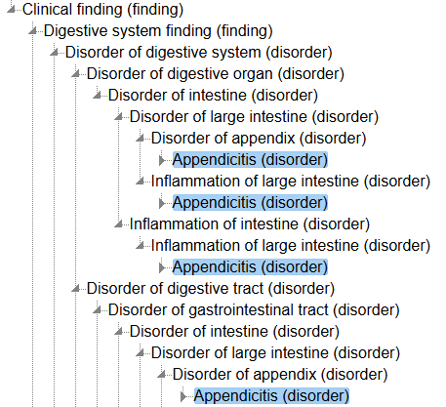
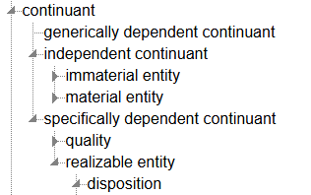
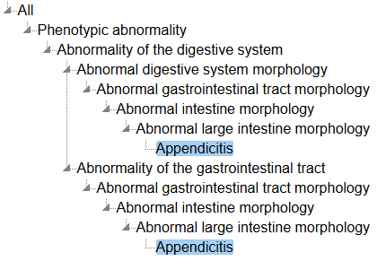
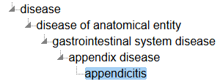
Appendicitis in different biomedical ontologies
SNOMED CT
NCIT
MONDO
HPO
DO

Slide 8
Disease vs. Disorder
 | Disease | Disorder
OGMS → DO | A disposition (specifically dependent continuant) to undergo pathological processes that exists in an organism because of one or more disorders in that organism. | A material entity which is a causally relatively isolated combination of physical components of an organism that is clinically abnormal.
NCIT | Deviation from the normal structure or function of an organism, typically with known causes, progression, and manifestations. | abnormal condition that impairs the normal function of an organism
MONDO | A disease or disorder is a disposition to undergo pathological processes that exists in an organism because of one or more disorders in that organism.
SNOMED CT |  | Always and necessarily abnormal; necessarily have an underlying pathological process; have temporal persistence (may be under treatment, in remission, or inactive, even though they are still present); may be present as a propensity for certain abnormal states to occur, even when treatment mitigates or resolves those abnormal states
HPO | Describes the clinical features of a disease

Slide 9
Appendicitis in different biomedical ontologies
SNOMED CT
NCIT
bfo:disposition
bfo:object
bfo:object
bfo:process
MONDO
bfo:quality
HPO
bfo:disposition
DO

Slide 10
Design pattern for diseases
Appendicitis_Structure equivalentTo Object and bearerOf some Inflammatory_Morphology
Appendicitis_Quality equivalentTo Quality and inheresIn some (Appendix_Structure and (participatesIn some Appendicitis_Process))
Appendicitis_Process equivalentTo Inflammatory_Process and hasParticipant some Appendicitis_Structure
Having_Appendicitis equivalentTo Having_Condition and hasPart some Appendicitis_Process
Appendicitis_Diagnosis equivalentTo Diagnosis and isAbout some (hasGranularPart some Having_Appendicitis)
Appendicitis_Quality
Having_Appendizitis
Mutual dependency – logical polysemy
Appendicitis_Process
Appendicitis_Structure

Slide 11
Logical polysemy
A language term has multiple, systematically related meanings (mostly mutually related, see appendicitis example)
Classical example "Book" (information entity vs. material copy)
"JD Salinger wrote only one book: The Catcher in the Rye"
The book "The Catcher in the Rye" was printed 65 million times
"Dot types"
Material • Information (book, gene)
Material • Process (tumour, diet)
Material • Quality (anemia)
Process • Quality (hypertension)
Common misunderstanding
"The bipartition of the world into continuants and occurrents is nonsense: E.g., tumours are both" (from conversation with medical standards developer)
James Pustejovsky, The Generative Lexicon, 1995, MIT Press.

Slide 12
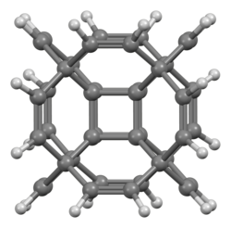
Logical polysemy vs. real polysemy
Real polysemy
Disposition vs. Realization: Ex.: nickel allergy, suicidality, hypertension, ability to wash themselves. Dispositions do not imply their realizations
Molecular entities vs. collections (aggregates) of molecular entities: different kinds of collections with the same base entities, but different structures, e.g. graphite vs. diamond, water vs. ice
Products vs. ingredients of products: Ibuprofen vs. Ibuprofen tablet, apple vs. packaged apple
Molecules vs. molecular graphs: Simulation of non-existing molecules
Measurement process + quantitative or qualitative result vs. observable + quantitative or qualitative result
Hypercubane

Slide 13
Scope of disease: extending and simplifying
Clinical condition includes
Signs: objective features of clinical interest (red eye, opacity in x-ray)
Symptoms: subjective features of clinical interest (headache, hallucinations)
Clinical condition most robustly represented as processual entity:
Includes states during which a certain phenomenon exists
Abnormal vs. normal: no ontological distinction
Examples: Bleeding on tooth eruption, baldness, wrinkles, moles, white skin
Diagnosis:
Disease: actual health problem happening in an organism
Diagnosis: the reference to a health problem in context (information entity)
"information about a condition, problem, diagnosis, or other event, situation, issue, or clinical concept that has risen to a level of concern" (HL7-FHIR)

Slide 14
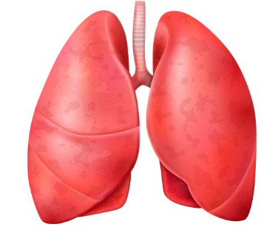

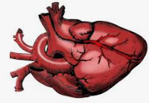

Disease vs. Diagnosis
Independent Continuant
Material Entity
Object
Fiat Object Part
Object Aggregate
Immaterial Entity
Site
Continuant Fiat Boundary
Spatial Region
Generically Dependent Continuant
Specifically Dependent Continuant
Quality
Realizable Entity
Disposition
Role
Function
Process
Process Boundary
Temporal Region
Spatiotemporal region
False diagnosis
Undiagnosed disease

Slide 15
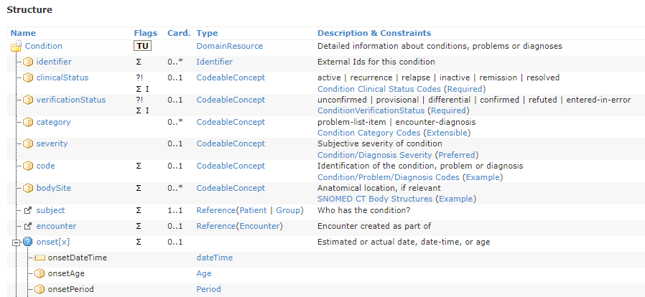
HL7-FHIR – Condition in context – framework for disease and related entities

Slide 16
Conclusion
Mapping problems
In particular, central domain terms often lack clear ontological definitions
Competing meanings often refer to different aspects of the same complex phenomenon
These different aspects belong to different categories, which are mutually dependent (known as logical polysemy)
For ontology mapping / alignment
Find out the explicit or implicit conceptualization of the concept (mapping candidate) in the target ontology
Develop and use representational pattern that precisely represents the source and the target

Slide 17
Appendix

Slide 18
Ontological clarity matters, particularly if used in healthcare and biomedical research
Data integration between health records and datasets for investigation
Decision support in healthcare
Comparability of study cohorts
Health statistics
Public health surveillance
Resource utilization and reimbursement

Slide 19
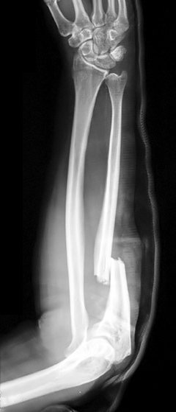
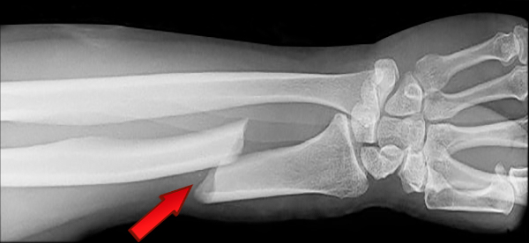
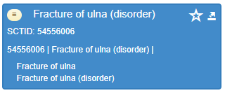
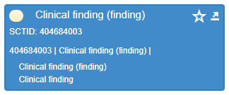
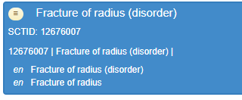
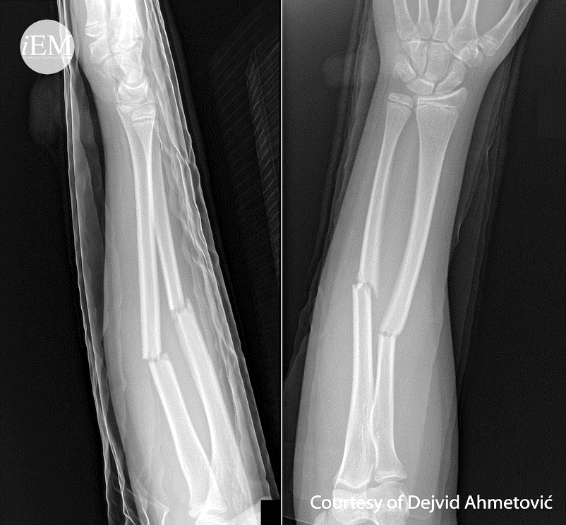
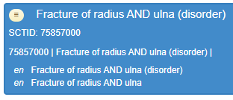
Example - what is a clinical finding in SNOMED CT?
subclassOf
subclassOf
subclassOf
subclassOf
'Fracture of Ulna' EquivalentTo: 'Clinical Finding' and 'role group' some (('finding site' some 'Bone structure of ulna') and ('associated morphology' some Fracture))
'Fracture of Radius' EquivalentTo: 'Clinical Finding' and 'role group' some
(('finding site' some 'Bone structure of radius') and ('associated morphology' some Fracture))
'Fracture of Radius and Ulna' EquivalentTo: 'Clinical Finding‘
and 'role group' some (('finding site' some 'Bone structure of radius') and ('associated morphology' some Fracture)) and 'role group' some (('finding site' some 'Bone structure of ulna') and ('associated morphology' some Fracture))

Slide 20
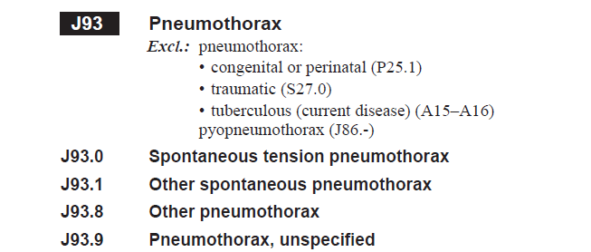
Special case: classification systems
International Classification of Diseases (ICD-10)

Slide 21
"Celestial Emporium of Benevolent Knowledge"
Satirical example of classification systems by Jorge Luis Borges
An ancient encyclopedia supposedly divides animals into the following 14 categories:
pertenecientes al Emperador
embalsamados
amaestrados
lechones
sirenas
fabulosos
perros sueltos
incluidos en esta clasificación
que se agitan como locos
innumerables
dibujados con un pincel finísimo de pelo de camello
etcétera
que acaban de romper el jarrón
que de lejos parecen moscas
those belonging to the Emperor
embalmed ones
trained ones
suckling pigs
mermaids
fabulous ones
stray dogs
those included in this classification
those that tremble as if they were mad
innumerable ones
those drawn with a very fine camel hair brush
et cetera
those that have just broken the vase
those that from afar look like flies

